Slide 1
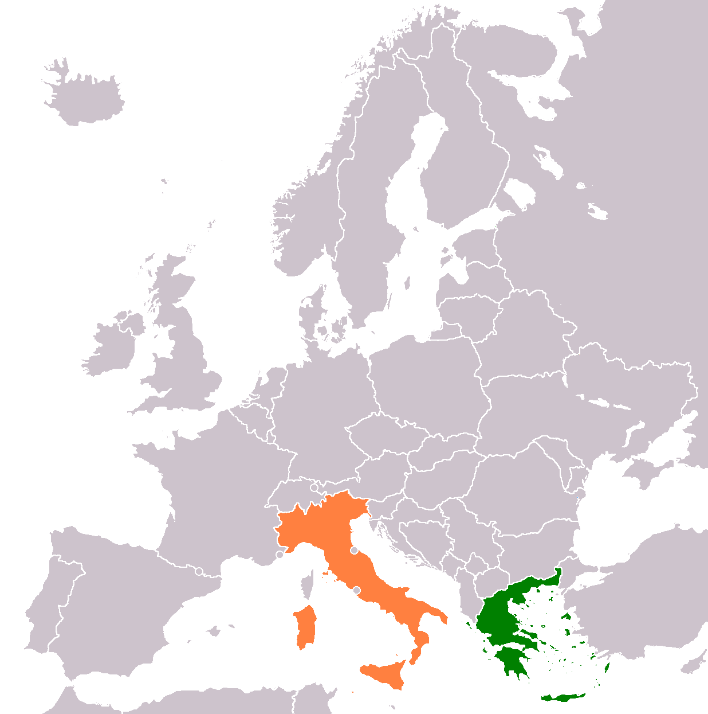
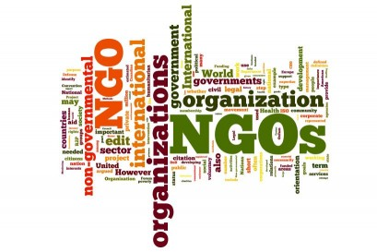
Second Language Education in Italy and Greece: The Role of NGOs in Supporting Refugee and Migrant Adult Learners
PhD Candidate Arsenia Anagnou
University of Alicante
Introduction
Results
  This paper presents critically the non-formal education which NGOs in Italy and in Greece provide to adult refugees. In Europe, due to its geopolitical location, these countries have been mostly transiting countries and they received the greatest percentage of migratory streams, especially during the 'refuge crisis' which flooded the last decade. International and European organizations establish and institutionalize refugee education and the host countries are willing to support refugees' integration. On the adult education portion, it is stated that there is a pedagogical shortfall in the delivery of education to adult refugees and there is no official policy in that target group. Pilot programs are planned and implemented to refugee camps to equip adults to new terms of everyday life.
  Key differences between NGO-led non-formal education in Italy and Greece include:
  Official Policy Frameworks: Italy has more structured national and regional policies supporting adult refugee education. Greece demonstrates a more fragmented policy landscape, often relying heavily on NGO initiatives without comprehensive state coordination.
  Instructional Approach (Synthetic vs. Analytic):Italian programs tend to adopt a synthetic approach, emphasizing structured grammar and sequential language learning. Greek programs are more likely to employ an analytic approach, focusing on communicative competence and language use in real-life situations.
  Pedagogical Orientation: Italian NGO programs often emphasize learner-centered pedagogy, encouraging active participation and individualized learning paths. Greek programs may lean more toward teacher-centered methods, with a stronger focus on direct instruction and classroom control.
References
Adelman, E.& Bellino, M.& Chopra,V.& Dryden-Peterson, S. (2019). The Purposes of Refugee Education: Policy and Practice of Including Refugees in National Education Systems. Harvard Graduate School of Education. Sociology of Education. doi:10.1177/1477878515622703. http://nrs.harvard.edu/urn-3:HUL.InstRepos:23989485
Beacco, J.-C., Krumm, H.-J., & Little, D. (2017). Introduction (English version). In J. C. Beacco,
H. J. Krumm, D. Little, & P. Thalgott (Eds), The linguistic integration of adult migrants. Some
lessons from research (pp. 1-5). Berlin/Boston: De Gruyter.
Council of Europe. (2017). List of all tools. Language Support for Adult Refugees. Tool 1-57. https://www.coe.int/en/web/language-support-for-adult-refugees/list-of-all-tools.
Czaika, M., & de Haas, H. (2015). The globalization of migration: Has the world become more migratory? International Migration Review, 48(2), 293.
Dryden-Peterson, S. (2015). The educational experiences of refugee children in countries of
first asylum. Washington, DC: Migration Policy Institute.
European Commission/EACEA/Eurydice, (2019). Integrating Students from Migrant
Backgrounds into Schools in Europe: National Policies and Measures. Eurydice Report.
Luxembourg: Publications.
Gattinara, P.C. (2017). The 'refugee crisis' in Italy as a crisis of legitimacy. Contemporary Italian Politics. Routledge Taylor& Francis Group. DOI: 10.1080/23248823.2017.1388639 pp.2-11.
Greek Council for Refugees. (2015). Schedule & Description of Pyxida GCR Activities. https://www.gcr.gr/en/pyxida-multicultural-center/schedule.
Kantzou, V.& Manoli, P.& Mouti, A.&Papadopoulou,M.(2017). Language education for refugees and migrants: Multiple case studies from the Greek context. Dialogues! Theory and Practice in the Sciences of Education. Vol.3, pp. 18-34 http://dx.doi.org/10.12681/dial.15000
Long, M. (2014). Second-language acquisition and task-based language teaching. Oxford, UK: Wiley Blackwell, pp.3-7.
Strychnou,S.V. (2020). Greek Educators’ Views on Migrant: Social-Demographic Differences. Department of Psychology, South-West University “Neofit Rilski”, Blagoevgrad, Bulgaria. Vol. 13(1), 12-36, https://doi.org/10.37708/psyct.v13i1.367.
Tarone, E.& Bigelow, M.& Hansen, K. (2009). Literacy and oracy in second language acquisition. Oxford: Oxford University Press. 34(1) pp. xi, 141.
UN DESA (UN Department of Economic and Social Affairs). (2017a). International Migrant Stock: the 2017 Revision. Monitoring Global Population Trends. New York, UN DESA. https://www.un.org/en/development/desa/population/migration/data/estimates2/docs/MigrationStockDocumentation_2017.pdf.
UNESCO & UNICEF. (2020) Approaches to Language in Education for Migrants and Refugees in the Asia-Pacific Region. United Nations Educational, Scientific and Cultural Organization, France and UNESCO Bangkok Office. ISBN 978-92-9223-653-3.
UNESCO. (2018c). Education and Migration: Language, Education and Migration in the Context of Forced Displacement. Paris: UNESCO.
UNHCR. (2017). Left Behind: Refugee Education in Crisis. http://www.unhcr.org/left-behind/.
Areas of research
This study focuses on several key research areas: Bilingual and Multilingual Education, Language Acquisition and Development, Intercultural Education, Language Policy and Planning, Educational Equity and Inclusion, Second Language Acquisition, Non-formal language education for Adult Refugees, and the Educational Programs implemented by NGOs in Italy and Greece.
Research methodology
Research problem
  The methodology employed by this study is bibliographic, applying the systematic review and critical analysis of literature on adult refugee non-formal education. The study is based on scholarly papers, policy reports, institution documents, and official statistics of international organizations like the UNHCR, the European Commission, and member NGOs.
With regard to adult refugee education, short attention and a significant lack of inclusive policy accomplishment still exist. In practice, the first form of educational provision for adult refugees takes place in non-formal education courses, primarily conducted by NGOs in refugee camps. Both Italy and Greece have created and implemented education systems to serve this target group, though largely outside the formal state education system. The aim is to explore how NGOs in Italy and Greece design and implement non-formal education courses, and to examine how inclusive policy frameworks for adult refugee education are functioning.
Conclusion
While NGOs play a crucial role, host counties must also provide specialized language education for adult refugees because greater educational support not only meets the needs of refugees but also enhances refugees' potential for contribution to the hosting nation; something Italy and Greece's experiences show requires more formal, comprehensive programs.

